Slide 1
BOAT AMERICA
A Course on Responsible Boating
Chapter 1
Presented by the U.S. Coast Guard Auxiliary

Slide 2
Class Plan
Chapter One:
Chapter Two:
Chapter Three:
Chapter Four:
Chapter Five:
Chapter Six:
Know Your Boat
Before You Get Underway
Operating Your Boat…Safely
Legal Requirements of Boating
Boating Emergencies…What to Do
Enjoying Water Sports With Your Boat

Slide 3
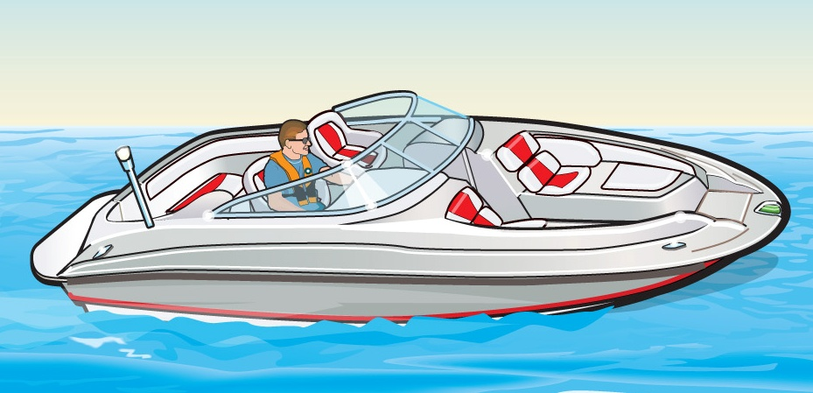
Chapter 1
Know Your Boat

Slide 4
Key Topics
Parts of a Boat
Types of Boat Hulls
Length of a Vessel
Types of Engines and Drives
Personal Watercraft
Sailboats
Notes:
Review the Key Topics with the class. This chapter may seem basic to experienced boaters, but new boaters need to learn the proper terms used in boating.

Slide 5
Objectives
You should be able to…
Identify the basic parts of a boat, a personal watercraft, and a sailboat.
Identify the different types of hulls and their performance characteristics.
Identify the different kinds of engines commonly found in recreational vessels.
Notes:
Talk about the objectives of the chapter.

Slide 6
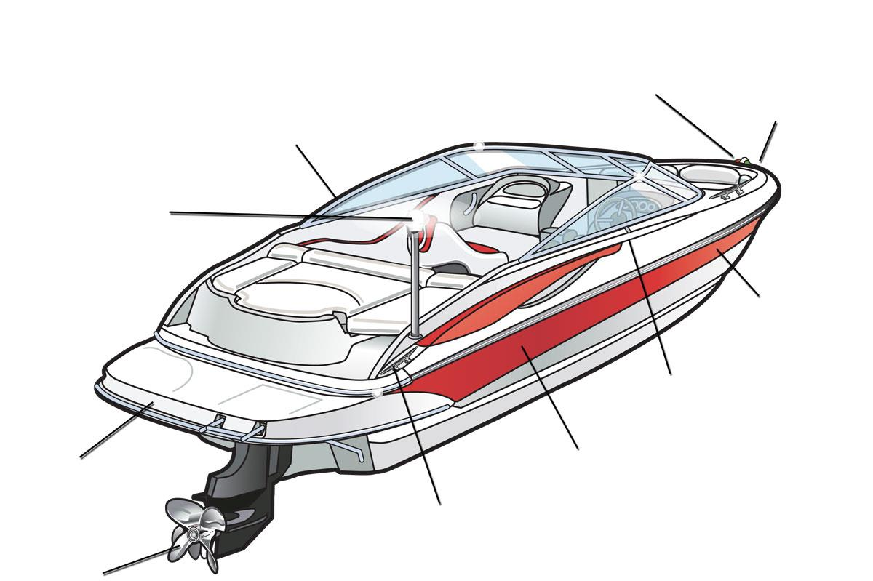
The Many Parts of a Boat
red and green sidelights
bow
port
all-round white light
hull
gunwale
stern
starboard
cleat
propeller
Notes:
Get the students to name the parts of the boat before activating the animation.
Ask: Why are these important to know?
Classroom training aid: pass around a model boat and have each student name one boat term.

Slide 7
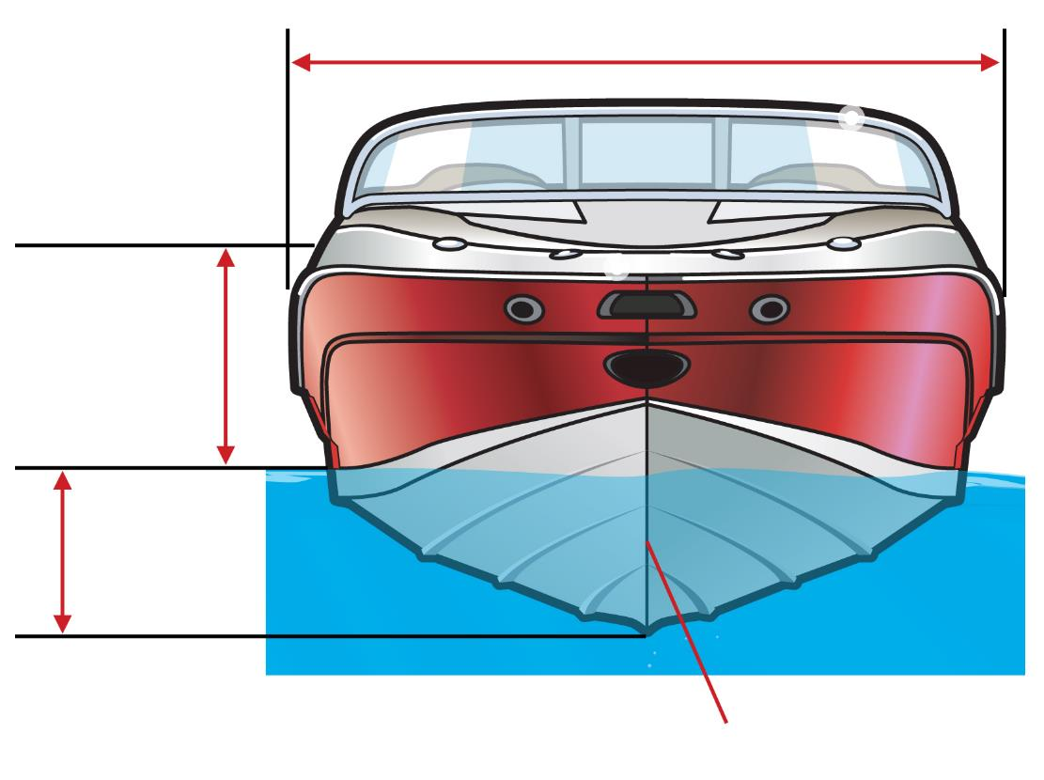
The Many Parts of a Boat
beam
freeboard
draft
keel
Notes:
Get the students to name the parts of the boat before activating the animation.
Ask: Why are these important to know?
Classroom training aid: pass around a model boat and have each student name one boat term.

Slide 8
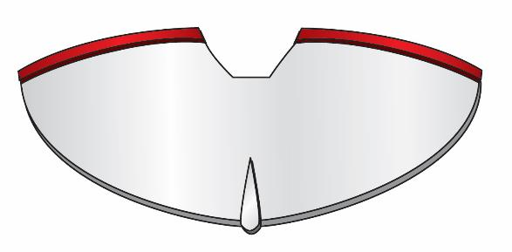
Types of Boat Hulls
Displacement Hulls
Round-Bottomed Hull
Round Bottom
Notes:
Discuss with students what these boats are used for and how “Displacement” hulls move through the water.

Slide 9
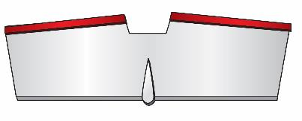
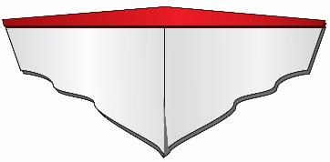
Types of Boat Hulls
Planing Hulls
Flat-Bottomed Hull
Vee-Bottomed Hull
Flat Bottom
Vee Bottom
Notes:
Discuss with students what these boats are used for. Discuss how “Planing” hulls move through water.

Slide 10
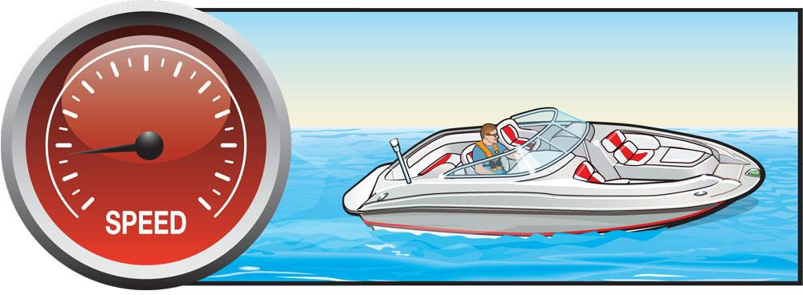
Types of Boat Hulls
How Planing Hulls Operate
Displacement Mode
Notes:
Instructor Notes:
Ask: What are the three main types of hulls?
Display Bullet one: Displacement.
Ask: What are the characteristics of a displacement hull?
Ask: What are some examples of displacement hulls?
Display Bullet two: Planing
Ask: What are the characteristics of a planing hull?
Ask: What are some examples of planing boats?
Display Bullet three: Combination
Ask: Why is this important to know?
Responses: Boats need to be used for the activity for which they were designed.

Slide 11
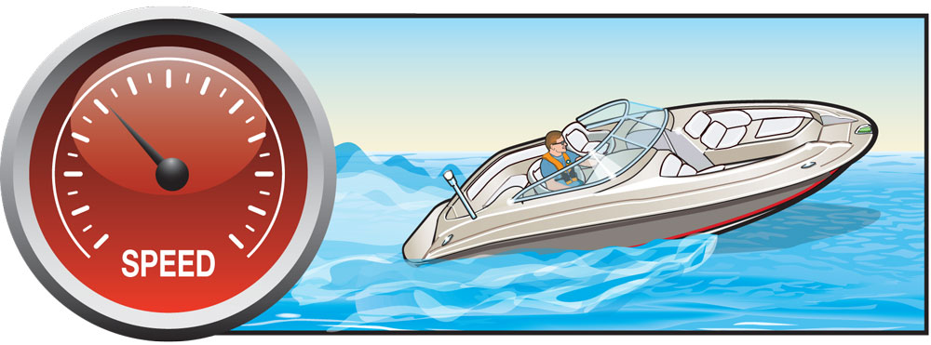
Types of Boat Hulls
Plowing Mode
Notes:
Instructor Notes:
Ask: What are the three main types of hulls?
Display Bullet one: Displacement.
Ask: What are the characteristics of a displacement hull?
Ask: What are some examples of displacement hulls?
Display Bullet two: Planing
Ask: What are the characteristics of a planing hull?
Ask: What are some examples of planing boats?
Display Bullet three: Combination
Ask: Why is this important to know?
Responses: Boats need to be used for the activity for which they were designed.

Slide 12
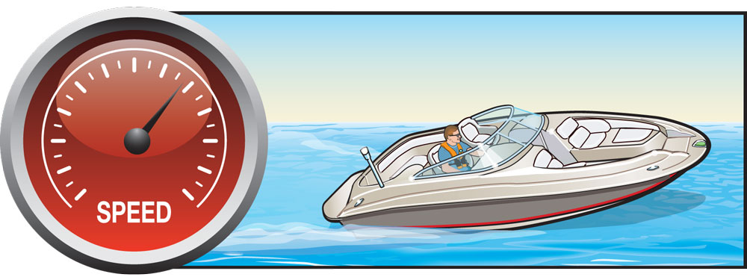
Types of Boat Hulls
Planing Mode
Notes:
Ask: What are the three main types of hulls?
Display Bullet one: Displacement.
Ask: What are the characteristics of a displacement hull?
Ask: What are some examples of displacement hulls?
Display Bullet two: Planing
Ask: What are the characteristics of a planing hull?
Ask: What are some examples of planing boats?
Display Bullet three: Combination
Ask: Why is this important to know?
Responses: Boats need to be used for the activity for which they were designed.

Slide 13
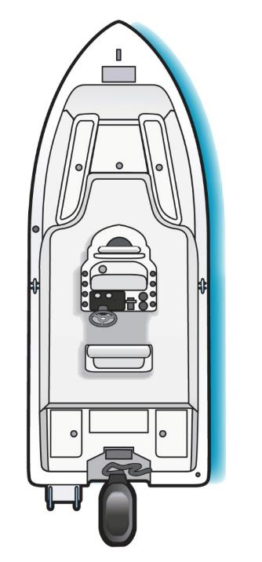
Length of a Vessel
Notes:
Ask a student to come up and show how he/she thinks the length would be measured on an outboard boat. Then ask the class if they agree.

Slide 14
Length of a Vessel
Notes:
Ask another student to come up and show how he/she thinks the length would be measured on an inboard boat. Then ask the class if they agree.

Slide 15
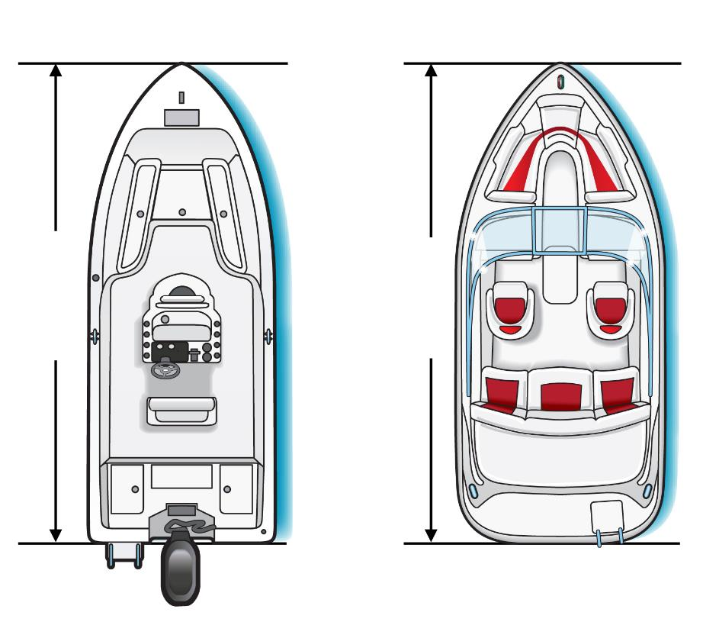
Length of a Vessel
Outboard
Inboard
Length
Length
Notes:
Review the way vessel length is measured. Also discuss why length is important for determining number and types of required equipment on board as well as registration fees.

Slide 16
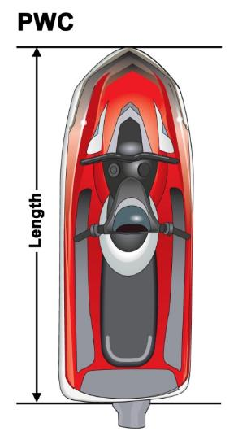
Length of a Vessel
Less than 16 feet (Class A)
16 feet to less than 26 feet (Class 1)
26 feet to less than 40 feet (Class 2)
40 feet to less than 65 feet (Class 3)
Notes:
Discuss the classes.
Point out that boat length is the factor for deciding amounts and types of safety gear and other federal requirements.

Slide 17
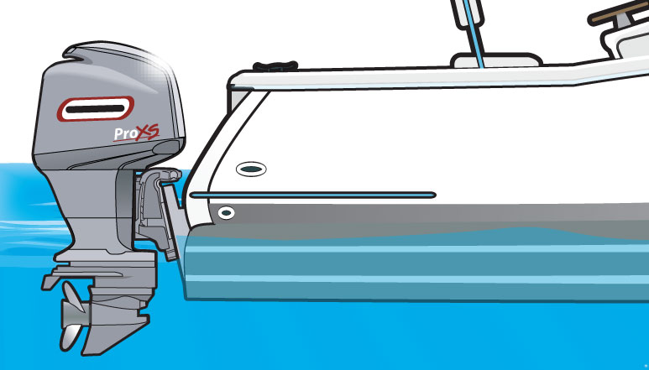
Types of Engines and Drives
Outboards
Notes:
Ask the class about the various types of engines on a boat: Outboard, Inboard, Inboard/Outboard (I/O), and Jet Drive. Discuss the attributes of the Outboard: Ease of maintenance, More space in the boat since the outboard is on the transom, shallower draft, better fuel economy, gasoline power, easier to maneuver than inboard or dual prop.
Ask: the question on the slide.
Responses: Outboard, Inboard/Outboard, or Stern drive, Inboard, Jet.
We’ll discuss them
Ask: What are the advantages and disadvantages of the outboard?

Slide 18
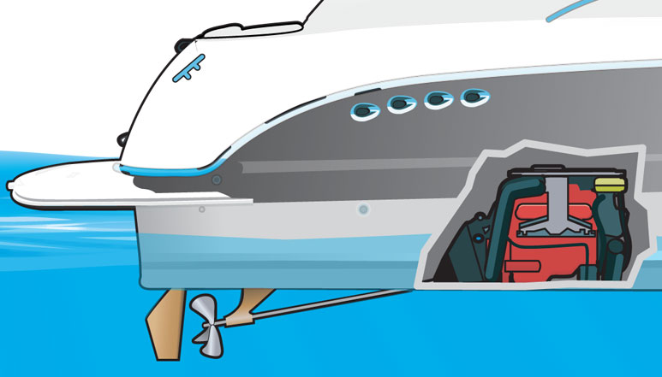
Types of Engines and Drives
Inboards
Notes:
Ask: What are the advantages and disadvantages of the inboard? Sits in the bottom on the boat providing better balance/stability, if diesel power more reliable, generally longer lifetime, more power both for the boat itself and equipment on board the boat, propeller deeper in the water.

Slide 19
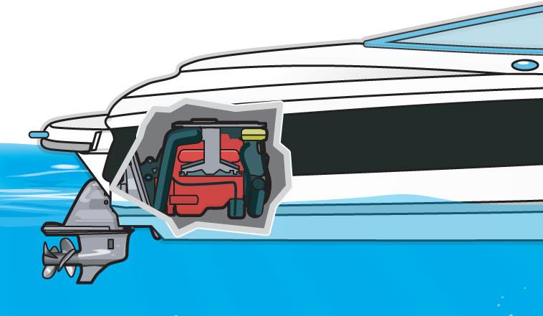
Types of Engines and Drives
Stern Drives
Notes:
Ask: What are the advantages and disadvantages of the I/O or stern drive? Ask: What are the advantages and disadvantages of the inboard? Sits in the bottom on the boat providing better balance/stability, if diesel power more reliable, generally longer lifetime, more power both for the boat itself and equipment on board the boat, propeller deeper in the water.

Slide 20
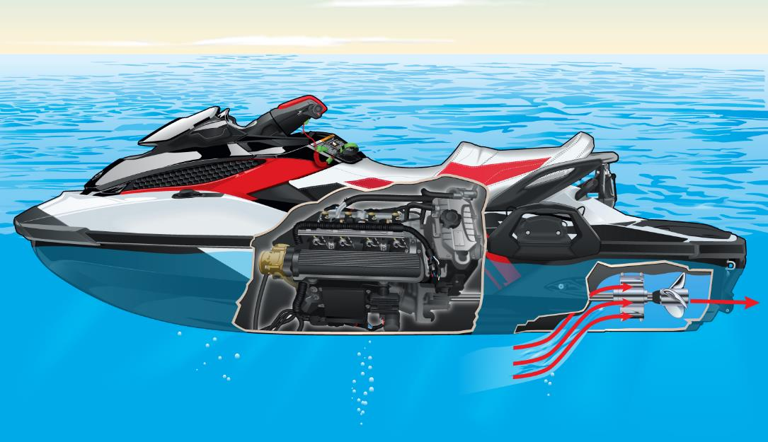
Types of Engines and Drives
Jet Drives
Notes:
This is classified as an inboard boat. Lighter gasoline powered engine. Fast, easy to maneuver; but needs to stay away from dirt and gravel than could clog the intake. Needs to be running in order to steer.
Ask: What are the advantages and disadvantages of the jet drive?
Remind again of off throttle steering.

Slide 21
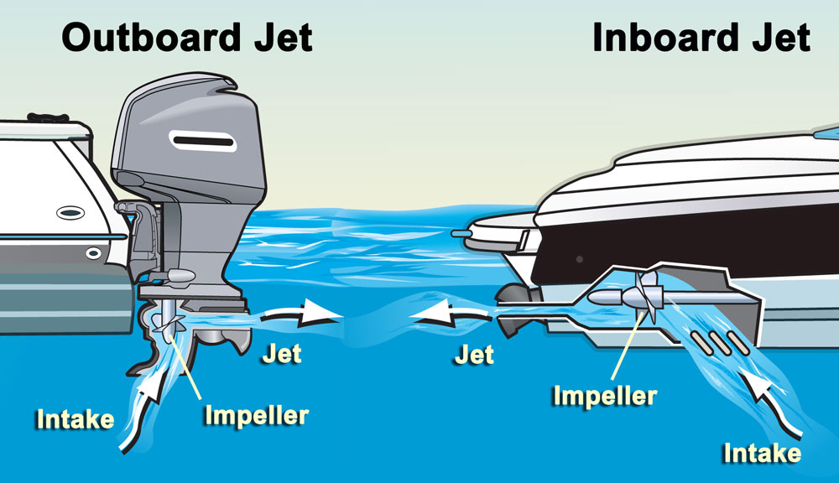
Types of Engines and Drives
Jet Drives

Slide 22
Personal Watercraft
Jet-propelled watercraft come in many sizes. The personal watercraft (PWC) is the most common for recreational boaters.
PWC:
Use an inboard jet drive as primary source of propulsion.
Are included in the group of inboard vessels less than 16 feet in length.
Are subject to the same laws and requirements of any other vessel plus some specific to PWC.

Slide 23
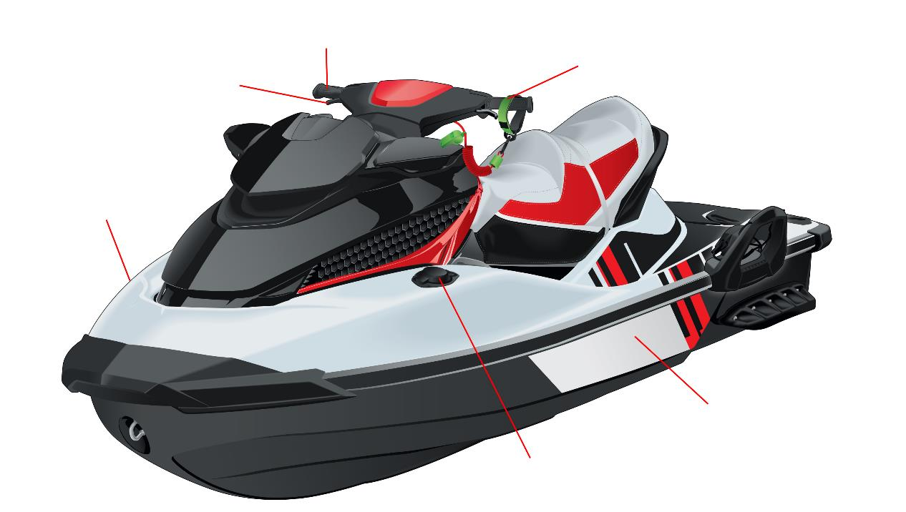
Personal Watercraft
steering control
safety lanyard
throttle lever
starboard
port
fuel cap
Notes:
Ask: What two important safety items are unique to jet drive/PWCs? Discuss the importance of the safety lanyard. Discuss danger of fire on board. Fuel tank is under the seat.
Discuss: off throttle steering and safety lanyard.

Slide 24
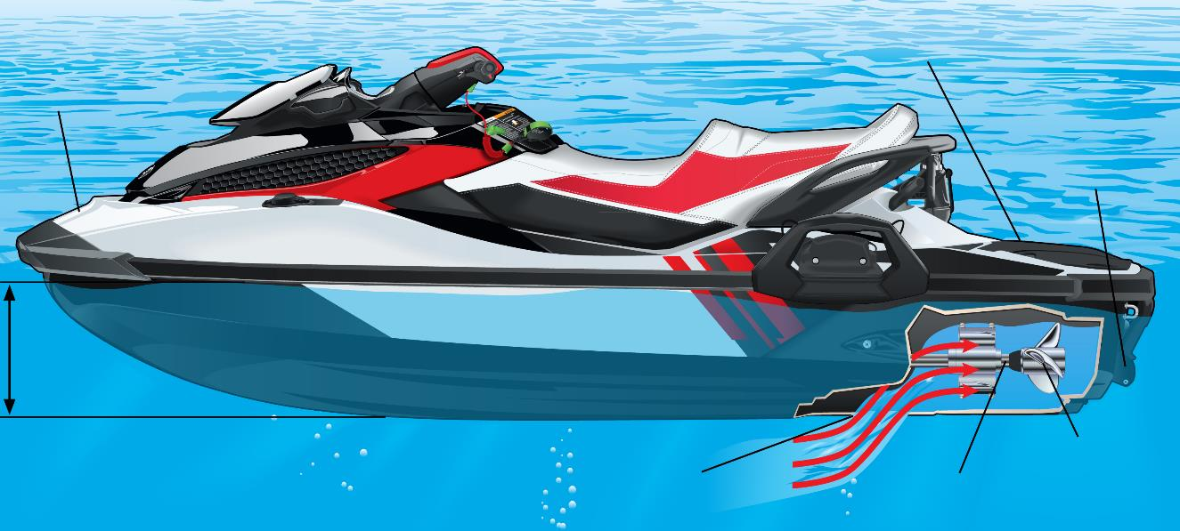
Personal Watercraft
stern
bow
steering nozzle
draft
jet pump intake grate
drive shaft
impeller
Notes:
Discuss: advantages and disadvantages of jet drives

Slide 25
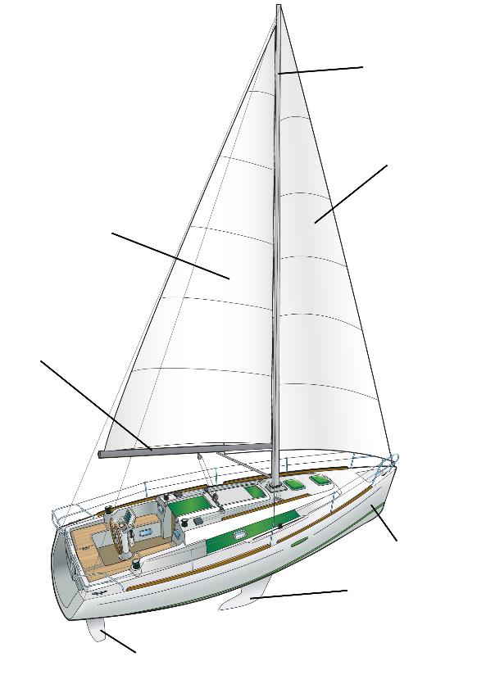
Sailboats
mast
halyards
headsail
(jib)
mainsail
sheet
boom
hull
keel
rudder
Notes:
Ask: Students to identify parts before running animation. This is to review common sailing terminology.
Mast is the vertical pole that supports the sails, which allows the wind to propel the ship.
Headsail or Jib refers to any sail that sits forward of the mast.
Hull is the watertight body of a ship.
Keel adds stability and center of gravity to prevent the boat from being blown sideways and keep the boat up-right.
Rudder is a primary control surface used to steer a ship.
Boom is the horizontal pole which extends from the bottom of the mast. Adjusting the boom towards the direction of the wind in order to move and turn the boat.
Sheet is a line (rope, cable or chain) used to control the movable corner(s) (clews) of a sail.
Mainsail is the sail rigged on the main mast of a sailing vessel.
Halyard is a line used to raise or lower a sail, flag, spar or yard.

Slide 26
Chapter 1 Review

Slide 27
Review Exercises
The maximum width of the hull is known as the:
Quarter.
b. LOA.
c. Beam.
d. Tiller.

Slide 28
Review Exercises
Freeboard is the:
Right side of a boat when facing the bow.
b. Distance from the water to the lowest point of a boat where water could come aboard.
c. Height of a boat’s gunwale measured inside the cockpit.
d. Provision of food and quarters for volunteer crews on ocean races.

Slide 29
Review Exercises
The measurement of how deeply a boat’s hull penetrates the water is its:
a. Draft.
b. Head.
c. Helm.
d. Beam.

Slide 30
Review Exercises
A displacement hull is one that:
a. Skims along the surface of the water.
b. Moves through the water pushing it aside.
c. Is capable of very high speeds.
d. May easily capsize in heavy seas.

Slide 31
Review Exercises
Required on-board equipment for a boat to comply with Federal law is determined by:
a. The boat’s freeboard.
b. The boat’s state registration fee.
c. The boat’s weight.
d. The boat’s overall length

Slide 32
End Chapter 1

